Slide 1


Course Title: Programming Fundamentals Course Code: CS141
Assiut University
كلية معتمدة من الهيئة القومية
لضمان جودة التعليم والاعتماد
Prof. Khaled F. Hussain

Slide 2
An Overview of Computers and Programming Languages

Slide 3
Reference
D. S. Malik, “C++ Programming: From Problem Analysis to Program Design”, Cengage Learning

Slide 4





Computer Languages
Machine language
The language of a computer, called machine language, is a sequence of 0s and 1s.
To see how instructions are written in machine language, suppose you want to use the equation:
wages = rate · hours
to calculate weekly wages.
Further, suppose that the binary code 100100 stands for load,
100110 stands for multiplication, and
100010 stands for store.
In machine language, you might need the following sequence of instructions to calculate weekly wages:
100100 010001
100110 010010
100010 010011

Slide 5


Computer Languages (Cont.)
Assembly language
Using assembly language instructions, you can write the equation to calculate the weekly wages as follows:
LOAD rate
MULT hours
STOR wages
A program called an assembler translates the assembly language instructions into machine language.

Slide 6


Computer Languages (Cont.)
High-level languages
FORTRAN, COBOL, C, C++, C#, Java, and Python
In C++, you write the weekly wages equation as follows: wages = rate * hours;
The instruction written in C++ is much easier to understand.
A program called a compiler translates instructions written in high-level languages into machine code.

Slide 7
My first C++ program
#include <iostream>
using namespace std;
int main()
{
cout << "My first C++ program." << endl;
return 0;
}
Sample Run:
My first C++ program.

Slide 8











Processing a C++ Program
Use the compiler to:
Check that the program obeys the rules
Translate into machine language (object program)
Linker:
Combines object program with other programs to create executable code
Loader:
Loads executable program into main memory

Slide 9

Processing a C++ Program (Cont.)

Slide 10
The Problem Analysis–Coding–Execution Cycle

Slide 11
The Problem Analysis–Coding–Execution Cycle (Cont.)
Compiler guarantees that the program follows the rules of the language (no syntax errors)
Does not guarantee that the program will run correctly

Slide 12





Graphic representation of the problem-solving process

Slide 13










Programming Tools
Three tools are used to convert algorithms into computer programs:
Flowchart - Graphically depicts the logical steps to carry out a task and shows how the steps relate to each other.
Pseudocode - Uses English-like phrases with some Visual Basic terms to outline the program.
Hierarchy chart - Shows how the different parts of a program relate to each other.

Slide 14


Algorithm
A step-by-step series of instructions for solving a problem (a recipe is an example of an algorithm)

Slide 15
Example 1
Design an algorithm to find the perimeter and area of a rectangle
Algorithm:
Get length of the rectangle
Get width of the rectangle
Find the perimeter using the following equation:
perimeter = 2 * (length + width)
Find the area using the following equation:
area = length * width

Slide 16
Example 1 (Cont.)
#include <iostream>
using namespace std;
int main() {
double length;
double width;
double area;
double perimeter;
cout << "Program to compute and output the perimeter and “ << "area of a rectangle." << endl;
length = 6.0;
width = 4.0;
perimeter = 2 * (length + width);
area = length * width;
cout << "Length = " << length << endl;
cout << "Width = " << width << endl;
cout << "Perimeter = " << perimeter << endl;
cout << "Area = " << area << endl;
return 0;
}

Slide 17
Example 2
How many stamps do you use when mailing a letter?
One rule of thumb is to use one stamp for every five sheets of paper or fraction.

Slide 18
Algorithm
1. Request the number of sheets of paper; call it Sheets. (input)
2. Divide Sheets by 5. (processing)
3. Round the quotient up to the next highest whole number; call it Stamps. (processing)
4. Reply with the number Stamps. (output)

Slide 19
Flowcharts
Graphically depict the logical steps to carry out a task and show how the steps relate to each other.

Slide 20
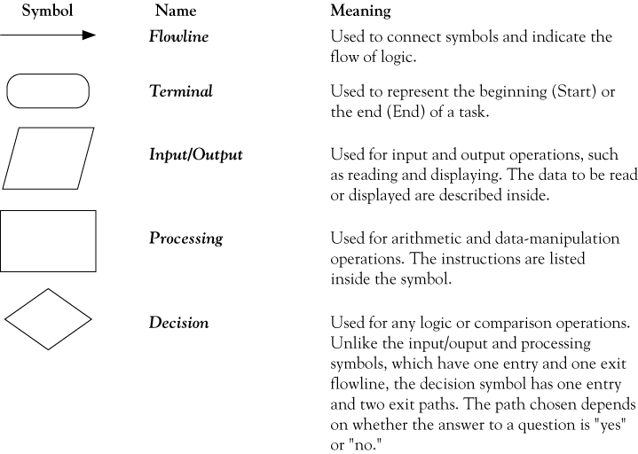







Flowchart symbols

Slide 21
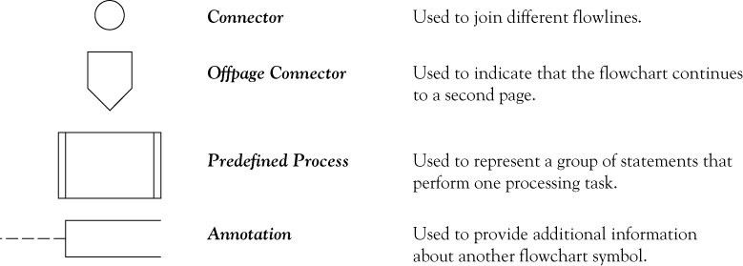
Flowchart symbols

Slide 22
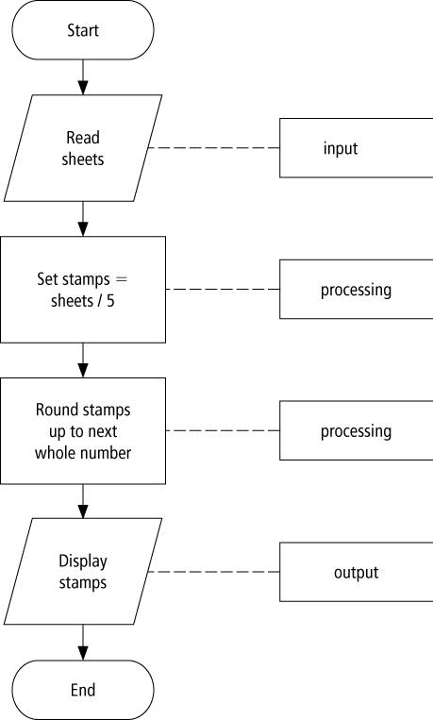
Flowchart example

Slide 23
Pseudocode
Uses English-like phrases with some C++ terms to outline the task.

Slide 24
Pseudocode example
Determine the proper number of stamps for a
letter
Read Sheets (input)
Set the number of stamps to Sheets / 5 (processing)
Round the number of stamps up to the next whole number (processing)
Display the number of stamps (output)

Slide 25
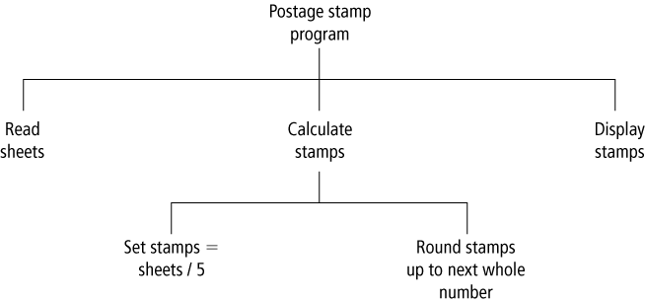
Hierarchy charts example

Slide 26
Divide-and-conquer method
Used in problem solving – take a large problem and break it into smaller problems solving the small ones first
Breaks a problem down into modules

Slide 27
1 //
2 // Addition program.
3 #include <iostream>
4
5 // function main begins program execution
6 int main()
7 {
8 int integer1; // first number to be input by user
9 int integer2; // second number to be input by user
10 int sum; // variable in which sum will be stored
11
12 std::cout << "Enter first integer\n"; // prompt
13 std::cin >> integer1; // read an integer
14
15 std::cout << "Enter second integer\n"; // prompt
16 std::cin >> integer2; // read an integer
17
18 sum = integer1 + integer2; // assign result to sum
19
20 std::cout << "Sum is " << sum << std::endl; // print sum
21
22 return 0; // indicate that program ended successfully
23
24 } // end function main
Declare integer variables.
Use stream extraction operator with standard input stream to obtain user input.
Calculations can be performed in output statements: alternative for lines 18 and 20:
std::cout << "Sum is " << integer1 + integer2 << std::endl;
Stream manipulator std::endl outputs a newline, then “flushes output buffer.”
Concatenating, chaining or cascading stream insertion operations.

Slide 28
Memory Concepts
Variable names
Correspond to actual locations in computer's memory
Every variable has name, type, size and value
When new value placed into variable, overwrites previous value
std::cin >> integer1;
Assume user entered 45
std::cin >> integer2;
Assume user entered 72
sum = integer1 + integer2;
integer1
45
integer2
72
integer1
45
integer2
72
sum
117

Slide 29
1 //
2 // Using if statements, relational
3 // operators, and equality operators.
4 #include <iostream>
5
6 using std::cout; // program uses cout
7 using std::cin; // program uses cin
8 using std::endl; // program uses endl
9
10 // function main begins program execution
11 int main()
12 {
13 int num1; // first number to be read from user
14 int num2; // second number to be read from user
15
16 cout << "Enter two integers, and I will tell you\n"
17 << "the relationships they satisfy: ";
18 cin >> num1 >> num2; // read two integers
19
20 if ( num1 == num2 )
21 cout << num1 << " is equal to " << num2 << endl;
22
23 if ( num1 != num2 )
24 cout << num1 << " is not equal to " << num2 << endl;
25
using statements eliminate need for std:: prefix.
Declare variables.
Can write cout and cin without std:: prefix.
if structure compares values of num1 and num2 to test for equality.
If condition is true (i.e., values are equal), execute this statement.
if structure compares values of num1 and num2 to test for inequality.
If condition is true (i.e., values are not equal), execute this statement.

Slide 30
26 if ( num1 < num2 )
27 cout << num1 << " is less than " << num2 << endl;
28
29 if ( num1 > num2 )
30 cout << num1 << " is greater than " << num2 << endl;
31
32 if ( num1 <= num2 )
33 cout << num1 << " is less than or equal to "
34 << num2 << endl;
35
36 if ( num1 >= num2 )
37 cout << num1 << " is greater than or equal to "
38 << num2 << endl;
39
40 return 0; // indicate that program ended successfully
41
42 } // end function main
Statements may be split over several lines.
Enter two integers, and I will tell you
the relationships they satisfy: 22 12
22 is not equal to 12
22 is greater than 12
22 is greater than or equal to 12

Slide 31
Examples
Write a program to calculate the volume of material in a pipe.

Slide 32
Examples (Cont.)
An old-style movie theater has a simple profit function. Each customer pays 50 pounds per ticket. Every performance costs the theater 500 pounds, plus 5 pounds per attendee. Write a program to calculate how much income the attendees produce.

Slide 33
Examples (Cont.)
The program prompts the user to enter a Fahrenheit temperature; it then prints the equivalent Celsius temperature.

Slide 34
Examples (Cont.)
Draw the Flowchart and write the Pseudocode for solving two simultaneous linear equations in two unknowns. The equations to be solved are:

Slide 35
Examples (Cont.)
Draw the Flowchart and write the Pseudocode for a weather forecasting program that writes the text shown in the rows and columns of the following table, depending on values of temperature and pressure supplied by the user. Define high temperatures to be above 20.0°C and high pressures to be above 1000,0 millibar.
 | High pressure | Low pressure
High temperature | Clear skies and hot | Warm with rain
Low temperature | Clear skies and cold | Snow

Slide 36
Examples (Cont.)
Write a program that calculates the taxi fee. The fee below 1500 meters is 10 pounds and 5 pounds for each 500 meters above 1500.
Write a program that finds the intersection between two lines: ax + by = c and dx+ey=f.

Slide 37
Examples (Cont.)
Checking Even or Odd
#include <iostream>
int main() {
int num;
std::cout << "Enter a number: ";
std::cin >> num;
if (num % 2 == 0) {
std::cout << num << " is even." << std::endl;
} else {
std::cout << num << " is odd." << std::endl;
}
return 0;
}

Slide 38
Examples (Cont.)
Swapping Two Numbers
#include <iostream>
int main() {
int a, b, temp;
std::cout << "Enter value for a: ";
std::cin >> a;
std::cout << "Enter value for b: ";
std::cin >> b;
std::cout << "Before swapping: a = " << a << ", b = " << b << std::endl;
temp = a;
a = b;
b = temp;
std::cout << "After swapping: a = " << a << ", b = " << b << std::endl;
return 0;
}

Slide 39


Programming Methodologies
Structured Programming
Dividing a problem into smaller subproblems is called structured design. Each subproblem is then analyzed, and a solution is obtained to solve the subproblem.
The solutions to all the subproblems are then combined to solve the overall problem.
Object-Oriented Programming
Object-oriented design (OOD) is a widely used programming methodology. In OOD, the first step in the problem-solving process is to identify the components called objects, which form the basis of the solution, and to determine how these objects interact with one another.
For example, suppose you want to write a program that automates the dvd rental process for a local dvd store. The two main objects in this problem are the dvd and the customer.

